Slide 1
Add Maximal Character in SKD Notes
P0230822 (C0024568)

Slide 2
Problem’s Detail
Description of Changes
When user create SKD transaction, user needs to input many information in SKD Notes.
Furthermore, SKD Notes will be sent to Staging MFAPPL then to MFAPPL after BAST Final transaction. Then we should pay attention about Note field’s length character in Staging MFAPPL and MFAPPL.
Root Cause
Note column in SKD screen can only hold 100 characters, while in Database, Note field can hold 500 characters.
Fixing
Lengthen maximal character for SKD Note both in screen and in database to 5.000 characters. Then change code when OLSS send the data to Staging MFAPPL, it will only send maximum 100 characters as existing. So there is no need to check Staging MFAPPL & MFAPPL. This solution is already agreed by user.

Slide 3
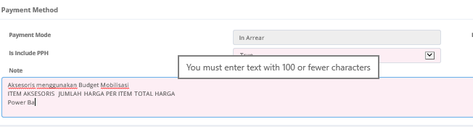
Before
In SKD Note, when we try to input more than 100 characters, then the mouse over will show notice: You must enter text with 100 or fewer characters.

Slide 4
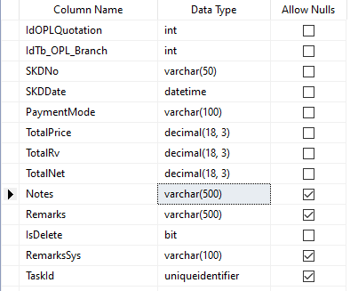
Before
In Table TB_MKT_SKD, field Notes data type is varchar(500)

Slide 5
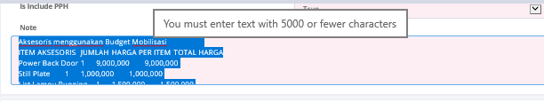
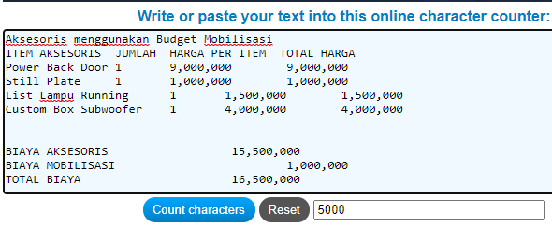
After
User can input up to 5000 characters in SKD Note. If user try to input more than 5000 characters, then the mouse over will show notice: You must enter text with 5000 or fewer characters.

